Slide 1


Programmatic view on ending Child Marriage in Uganda
Gerald Kato, The Hunger Project Uganda
Notes:
Good morning everybody, my name is Gerald Kato and I am working as a project coördinator for the Her Choice programme at The Hunger Project Uganda. During this short presentation, I am going to give a programmatic view on ending child marriage in Uganda.

Slide 2
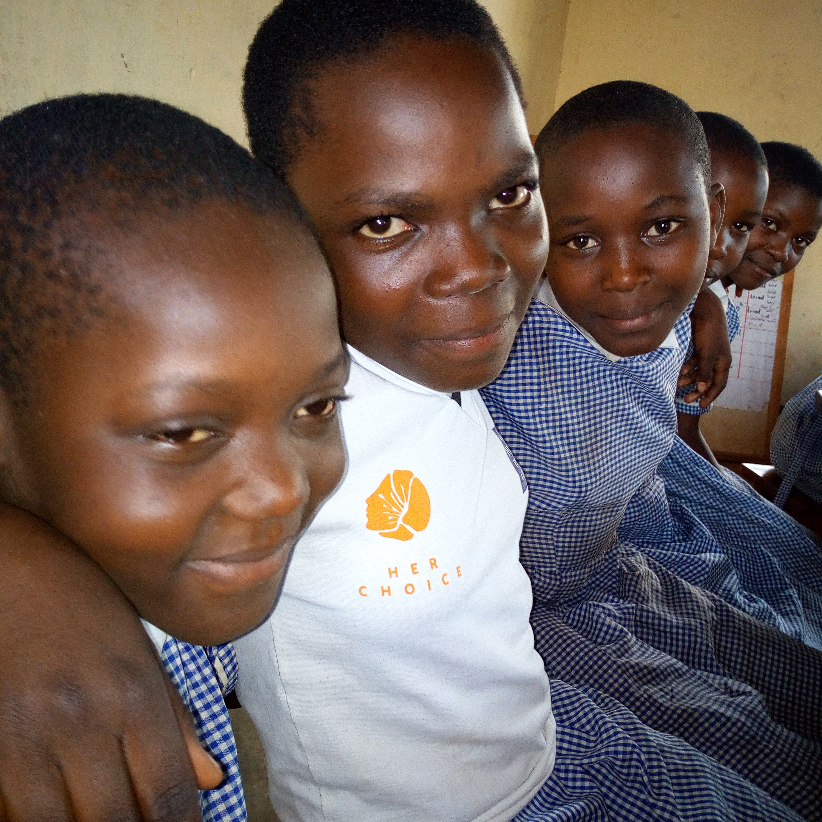
LEGAL CONTEXT IN UGANDA
The legal age of marriage is 18 without exceptions (Children Act 2016)
In 2015, GoU launched the National Strategy on Ending Child Marriage and Teenage Pregnancy.
40% of girls is still forced to marry before their 18th birthday, and 1 in 10 before the age of 15.
Notes:
I would like to start my presentation with a short description of the legal context in my country. As you can see on the slide, the legal context is quite favourable to fight child marriage since the Children Act 2016 criminalizes all marriages under 18 without expections. Furthermore, in 2015 the government launced a national strategy to end this harmful practice. Unfortunately, there is still 40% of girls who are forced to marry before their 18th birthday. 1 in 10 is even younger than 15.

Slide 3
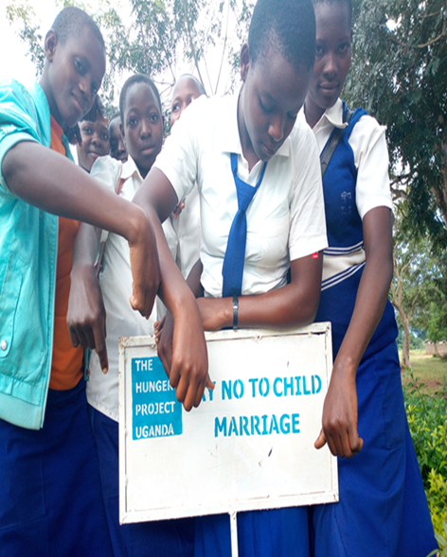
UNINTENDED CONSEQUENCES OF LAW ENFORCEMENT
Girls claiming their right and withdraw or refuse marriage become more vulnerable.
Informal child marriage still happen but now young children are forced to marry while still continuing their education.
Notes:
Law enforcement can have negative effects for girls. From the Her Choice program, we have learnt that girls who claim their right and withdraw or refuse to marriage tend to become very vulnerable, many drop-out or stay out-of-school because parents hold them responsible to contribute to the family income. This increases the chance for girls to be trapped in unsafe situation, which increases their risk of being trapped in in unsafe situation, for example though transactional sex.
We also see that child marriage continue to happen in an informal way. Perpetrators of child marriage now marry young children and keep them in school. Families which cannot support their children’s education identify suitors who are capable of paying school dues to marry off their daughters. As a result, parents reduce on bride price and then enter an agreement with the potential husband to take back their daughter to school.

Slide 4
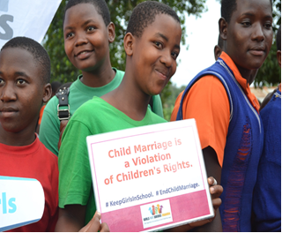
OUR PROGRAMMATIC RESPONSE
Create safe and empowering environment for girls.
Strenghtening the economic security of girls and their families.
Notes:
As a response to these unintended consequences, the Her Choice program strives to create a safe and empowering environment where girls feel supported by their families, school, community & LG. Furthermore, joint efforts for sustainable economic improvement are made to provide girls and young women the possibility to choose a better future.

Slide 5
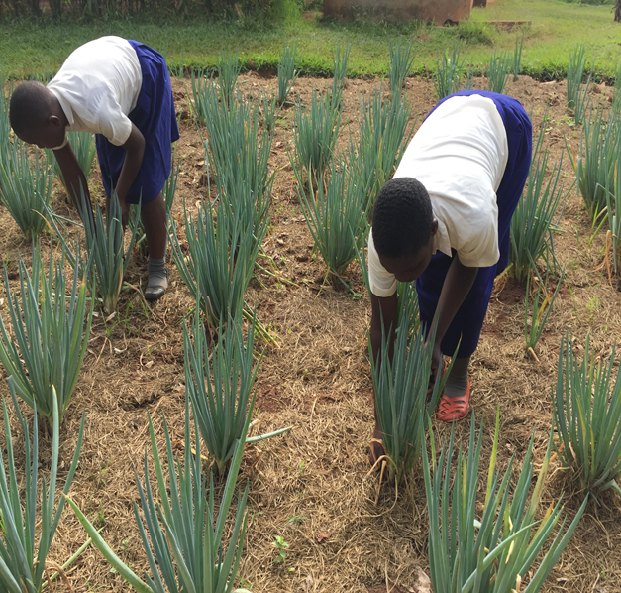
OUR PROGRAMMATIC RESPONSE
Capacity building in market-oriented productive vocational enterprises.
Community-level psychosocial support.
Notes:
To avoid girls becoming more vulnerable after refusing/withdrawing marriage, THP supports poor families and girls at risk (for example child mothers, young girls, HIV positive girls and girls heading H/H) to improve their economic security. We do this through capacity building in market-oriented productive vocational enterprises in areas of agro-business, craft making, tailoring, liquid soap making, basic life skills and entrepreneurship. Furthermore, we link up married girls or girls who withdraw from child marriage to trained THP women volunteers at community level for psychological support.

Slide 6





www.her-choice.org · info@her-choice.org

